Slide 2
Devotion:

Slide 3

Devotion:

Slide 4
IT Customer Relationship Management
IT CRM– Module 3
Cesar D. Galingana, MIT, LPT

Slide 5
MODULE 3:
Topic: Lead Management & Qualification

Slide 6

Lead Management & Qualification - It's the process of identifying, attracting, engaging, and assessing potential customers to determine their readiness to buy. It's where marketing and sales truly converge.

Slide 7
Lead Management & Qualification - It's the process of identifying, attracting, engaging, and assessing potential customers to determine their readiness to buy. It's where marketing and sales truly converge.

Slide 8
Why is this crucial for you?
✓ Whether you're in marketing (generating leads), sales (qualifying and closing leads), or even product development (understanding who needs your product), this process is fundamental.

Slide 9
Why is this crucial for you?
✓ Whether you're in marketing (generating leads), sales (qualifying and closing leads), or even product development (understanding who needs your product), this process is fundamental.

Slide 10
Why is this crucial for you?
✓ Whether you're in marketing (generating leads), sales (qualifying and closing leads), or even product development (understanding who needs your product), this process is fundamental.
✓ It's about efficiency: focusing your valuable time and resources on the people most likely to become profitable customers. Today, we'll define the journey from a casual interest to a committed customer, explore where leads come from, learn how to identify the most promising ones, and discuss strategies to nurture them towards a purchase.

Slide 11
Why is this crucial for you?
✓ Whether you're in marketing (generating leads), sales (qualifying and closing leads), or even product development (understanding who needs your product), this process is fundamental.
✓ It's about efficiency: focusing your valuable time and resources on the people most likely to become profitable customers. Today, we'll define the journey from a casual interest to a committed customer, explore where leads come from, learn how to identify the most promising ones, and discuss strategies to nurture them towards a purchase.

Slide 12
https://www.youtube.com/shorts/n2s1h4ReE_Y
Notes:
Think of customer data as the fuel for your CRM engine. If the fuel is contaminated, your engine will sputter, or worse, break down. Accurate and complete customer data is not just a nice-to-have; it's a strategic imperative.

Slide 13
1. Defining Leads, Prospects, and Customers: The Journey Stages

Slide 14
1. Defining Leads, Prospects, and Customers: The Journey Stages
a. Lead- An individual or organization that has shown some level of interest in your product or service, or whose characteristics suggest they might be a potential customer.
Characteristics: They might have filled out a form, downloaded content, visited a specific page, or simply fit your target demographic. They are potential future customers.
Example: Someone who downloaded your e-book on "Digital Marketing Trends." You know their email, but not much else about their specific needs or buying intent.

Slide 15
1. Defining Leads, Prospects, and Customers: The Journey Stages
b. Prospect - A qualified lead who has been identified as having a need for your product/service, the budget to purchase it, the authority to make a decision, and a timeline for purchase
Characteristics: They've engaged more deeply, perhaps requested a demo, had a discovery call, or explicitly stated a problem your product can solve. They are a potential customer with a higher likelihood of conversion.
Example: The person who downloaded your e-book then requested a free consultation call and discussed their company's specific marketing challenges.

Slide 16
1. Defining Leads, Prospects, and Customers: The Journey Stages
c. Customer- An individual or organization that has purchased your product or service.
Characteristics: They have completed a transaction and are now part of your client base. The focus shifts from acquisition to retention, satisfaction, and potentially advocacy.
Example: The prospect who signed a contract and paid for your digital marketing services.

Slide 17
2. Lead Generation Sources: Where Do They Come From?
a. Inbound Lead Generation (Attracting):
- Attracting potential customers by creating valuable content and experiences tailored to them. The customer initiates the contact.
Characteristics: Often more cost-effective and higher quality leads as they've shown interest.

Slide 18
2. Lead Generation Sources: Where Do They Come From?
Sources:
• Website/Blog: SEO (Search Engine Optimization) to rank high in search results, valuable blog posts, resource pages (e.g., whitepapers, e-books, templates) that require an email to download.
• Social Media: Engaging content, contests, direct messaging, social listening to identify needs.
•

Slide 19
2. Lead Generation Sources: Where Do They Come From?
• Content Marketing: Creating and distributing valuable, relevant, and consistent content to attract and retain a clearly defined audience (e.g., webinars, podcasts, videos, infographics).
• Email Marketing: Opt-in newsletters, content updates.
• Online Forms/Landing Pages: Dedicated pages designed to capture lead information in exchange for an offer.
• Referrals: Existing customers referring new business (often the highest quality leads).

Slide 20
2. Lead Generation Sources: Where Do They Come From?
b. Outbound Lead Generation (Reaching Out):
- Proactively reaching out to potential customers who may or may not have expressed prior interest.
Characteristics: Can be faster for immediate results, but often more expensive and lower conversion rates.

Slide 21
2. Lead Generation Sources: Where Do They Come From?
• Sources:
• Cold Calling: Directly calling potential customers.
• Email Outreach: Sending unsolicited emails to target lists (requires careful compliance with regulations).

Slide 22
2. Lead Generation Sources: Where Do They Come From?
• Sources:
• Paid Advertising:
• Search Engine Marketing (SEM): Paid ads on Google, Bing (e.g., Google Ads).
• Social Media Ads: Targeted ads on Facebook, LinkedIn, Instagram.
• Display Ads: Banner ads on websites.

Slide 23
2. Lead Generation Sources: Where Do They Come From?
• Events & Trade Shows: Collecting business cards, engaging in conversations, product demos.
• Direct Mail: Sending physical mailers.
• Telemarketing: Outbound calls by a call center.

Slide 24
2. Lead Generation Sources: Where Do They Come From?
C. Hybrid Approaches:
Many successful businesses use a combination of inbound and outbound strategies, leveraging CRM to track and manage leads from all sources.
Example: Running a paid ad campaign (outbound) that directs users to a landing page where they download an e-book (inbound lead capture). The key is to track which sources generate the most qualified leads and optimize your investment accordingly.

Slide 25
3. Lead Scoring Methodologies: Identifying the Hot Ones
Not all leads are created equal. Some are ready to buy now, others need more nurturing, and some may never be a good fit. Lead Scoring is a methodology used to rank leads based on their perceived value and readiness to buy. It assigns points to leads based on their characteristics (demographics, firmographics) and their engagement (behavior).

Slide 26
3. Lead Scoring Methodologies: Identifying the Hot Ones
a. Why Lead Scoring?
• Prioritization: Helps sales teams focus their efforts on the most promising leads, increasing efficiency and conversion rates.
• Alignment: Creates a common understanding between marketing and sales on what constitutes a "qualified" lead.
• Efficiency: Reduces wasted time on unqualified leads.
• Personalization: Allows for more tailored nurturing based on a lead's score.

Slide 27
3. Lead Scoring Methodologies: Identifying the Hot Ones
b. How Lead Scoring Works:
Leads are typically scored based on two main categories:
1. Demographic/Firmographic Fit (Implicit Scoring):
- How well a lead matches your ideal customer profile. This is often static information.
• Examples (B2C): Age, income, location, job title (if applicable).
• Examples (B2B): Company size (revenue, employees), industry, job title/seniority, location.
Scoring: Assign points for positive attributes (e.g., “ Director" = +10 points, "Student" = -5 points) and subtract points for negative ones.

Slide 28
3. Lead Scoring Methodologies: Identifying the Hot Ones
b. How Lead Scoring Works:
Leads are typically scored based on two main categories:
2. Behavioral Engagement (Explicit Scoring):
How a lead interacts with your company's content and website. This is dynamic and changes over time.
Examples:
• Positive Actions: Visiting pricing page (+15), requesting a demo (+20), opening emails (+5), downloading a whitepaper (+10), attending a webinar (+10).
• Negative Actions: Unsubscribing from emails (-10), visiting career page (-5), inactive for 30 days (-5).
Scoring: Points are added or subtracted based on these actions.

Slide 29
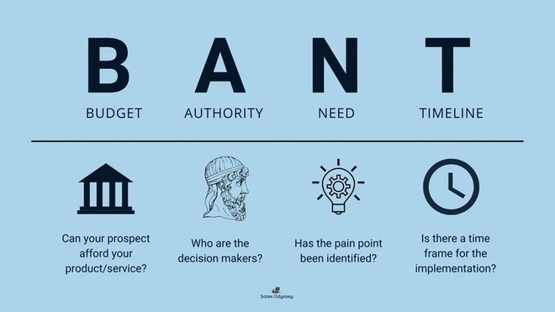
3. Lead Scoring Methodologies: Identifying the Hot Ones
c. Lead Scoring Thresholds
Once a lead accumulates a certain score, they cross a threshold and are passed from Marketing to Sales.
• Marketing Qualified Lead (MQL): A lead that is ready for sales engagement based on their score (e.g., score > 50). Marketing has nurtured them to a point where they are interested and fit the profile.
• Sales Qualified Lead (SQL): A lead that has been vetted by the sales team and confirmed to have a high likelihood of becoming a customer (e.g., score > 80, and a sales rep has confirmed BANT criteria).
Notes:
BANT - Budget, Authority, Need, and Timing

Slide 30
3. Lead Scoring Methodologies: Identifying the Hot Ones
d. Implementing Lead Scoring:
• Collaboration: Requires close collaboration between marketing and sales to define scoring criteria and thresholds.
• CRM/Marketing Automation Tools: Most CRM and marketing automation platforms (like HubSpot) have built-in lead scoring capabilities that automate the process.
• Continuous Optimization: Lead scoring models should be regularly reviewed and adjusted based on conversion rates and feedback from the sales team. Lead scoring transforms a large pool of leads into a prioritized list of opportunities, making sales efforts much more efficient.
Notes:
BANT - Budget, Authority, Need, and Timing

Slide 31
4. Lead Nurturing Strategies: Guiding Them to Conversion
Not every lead is ready to buy immediately. In fact, most aren't. Lead Nurturing is the process of building relationships with qualified prospects, regardless of their readiness to buy, by providing relevant information and support at each stage of their buyer's journey. It's about staying top-of-mind and building trust until they are ready to make a purchase.

Slide 32
4. Lead Nurturing Strategies: Guiding Them to Conversion
Why Lead Nurturing?
• Increased Conversion Rates: Nurtured leads convert at a significantly higher rate than non-nurtured leads.
• Reduced Sales Cycle: Helps move leads through the funnel faster.
• Builds Trust & Credibility: Positions your company as a helpful resource, not just a seller.
• Cost-Effective: More cost-effective to nurture existing leads than to acquire new ones.
• Personalization: Delivers content tailored to the lead's specific needs and stage in the buying process.

Slide 33
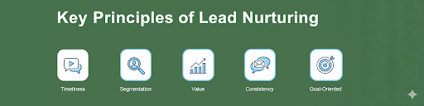
4. Lead Nurturing Strategies: Guiding Them to Conversion
b. Key Principles of Lead Nurturing:
• Relevance: Deliver content that is relevant to the lead's interests and challenges.
• Timeliness: Send content at the right time, based on their behavior or stage.
• Multi-Channel: Use a mix of channels (email, social media, retargeting ads, personalized website content, direct calls).
• Value-Driven: Focus on providing value, not just selling.
• Personalization: Address the lead by name, reference their past interactions, and tailor content.

Slide 34
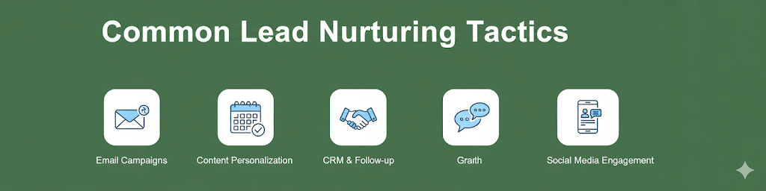
4. Lead Nurturing Strategies: Guiding Them to Conversion
c. Common Lead Nurturing Tactics:
• Email Nurturing Sequences (Drip Campaigns):
• Definition: A series of automated emails sent to leads over a period, triggered by specific actions (e.g., downloading an e-book, abandoning a cart).
• Content Examples: Educational content, case studies, testimonials, product comparisons, invitations to webinars.

Slide 35
4. Lead Nurturing Strategies: Guiding Them to Conversion
• Content Marketing:
- Providing valuable content (blog posts, whitepapers, videos, infographics) that addresses common questions and pain points of leads at different stages.
• Retargeting/Remarketing Ads:
- Showing targeted ads to leads who have visited your website but haven't converted.
• Personalized Website Experiences:
- Dynamically changing website content based on a lead's past behavior or known interests.

Slide 36
4. Lead Nurturing Strategies: Guiding Them to Conversion
• Social Media Engagement:
- Responding to comments, sharing relevant content, engaging in conversations.
• Webinars & Events:
- Offering educational webinars or inviting leads to industry events.
• Sales Outreach (for higher-scoring leads):
- Personalized calls or emails from sales reps once a lead reaches a certain qualification threshold.

Slide 37

4. Lead Nurturing Strategies: Guiding Them to Conversion
d. Automation in Lead Nurturing:
- Marketing automation platforms (like HubSpot) are essential for scaling lead nurturing efforts. They allow you to:
• Automate email sequences.
• Segment leads based on behavior and demographics.
• Trigger content delivery based on lead scores or actions.
• Track engagement and progress. Effective lead nurturing is a continuous conversation that guides potential customers towards a purchase decision, building trust and demonstrating value along the way.

Slide 38
Laboratory Activity: Build Your Lead Form (Hands-on HubSpot)
Set Up Your Lead Capture Form
• Access: Log in to your HubSpot Free CRM account.
• Your Task: Create a simple lead capture form in HubSpot. Imagine you're offering a free e-book or a newsletter sign-up.
1. Create a New Form: Go to Marketing > Lead Capture > Forms. Click "Create form."
2. Choose "Standalone Form": Select this option.
3. Add Fields: Include at least:
• First Name
• Last Name
• Email

Slide 39
One custom field (e.g., "Industry," "Company Size," "Favorite Beverage")
4. Customize Options:
• Give your form a clear name (e.g., "My E-book Download Form").
• Set a simple "Thank You" message after submission.
5. Publish & Test: Publish your form. Copy the link and open it in a new browser tab. Fill out your own form to test it.
6. Screenshot Proof: Take a screenshot of your published form (the live link, not the editor) and a screenshot of the submission confirmation in HubSpot (showing your test submission).

Slide 40
Lecture Activity - The Lead Journey (Individual Work)
Define & Differentiate
• Review: Think back to our lecture on "Lead Management & Qualification."
• Your Task: In your own words (2-3 sentences each), answer the following:
1. Lead vs. Prospect vs. Customer: Briefly define each term and explain how they differ.
2. Inbound vs. Outbound Lead Generation: Explain the difference and give one example of each.
3. Lead Scoring: Why is lead scoring important for a sales team?
4. Lead Nurturing: What is the main goal of lead nurturing?

Slide 41


END ….

Slide 42


